Slide 1
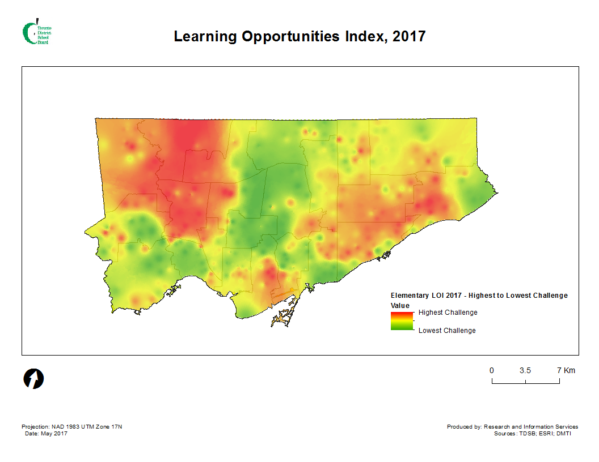
N=1813

Slide 2
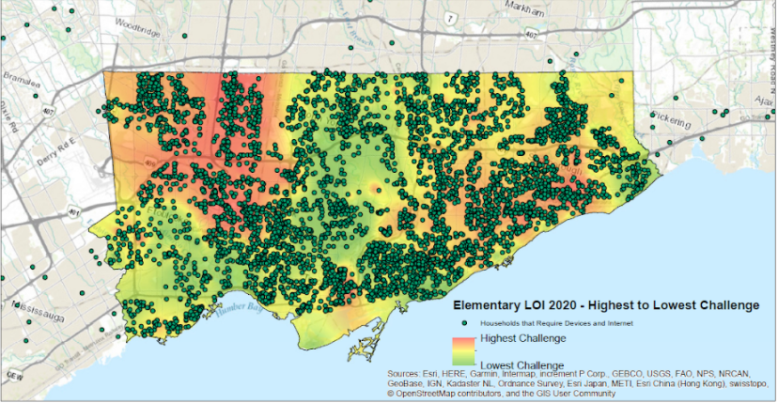
Computer Requests Spring 2020

Slide 3
Parental Income and Education: Socioeconomic Status

