Slide 1
INTRODUCING THE ICE COMMITTEE January 2025

Slide 2
Vehicle for Cross-Government Collaboration
Unique group cuts across program-specific silos to advance economic & labour force development in Toronto
Integrates labour-supply and business-demand considerations
Helps policy & program developers leverage relationships between their separate mandates
Identifies opportunities for collaboration & knowledge-sharing
Identifies policy & program gaps
Commissions and publishes independent non-partisan research
Hosts discussion forums for the broader sector

Slide 3
Membership
Canada, Ontario and Toronto Municipal employees responsible for supporting economic development, newcomer settlement or workforce development (currently from 15 different offices)
Members:
Advise on Committee priorities and activities
Contribute subject matter expertise and connections
Conduit between Committee and their Office (2-way sharing)
Promote ICE activities to colleagues and networks
An independent Chair hired by the Committee facilitates its activities

Slide 4
Partners
ICE Partners have Included:
ICE liaises and collaborates with other organizations
Partners may:
Co-host or volunteer as speakers & panelists at Discussion Forums
Co-fund and advise on Research projects
Volunteer as guest speakers at Committee Meetings
Staff can attend free Discussion Forums

Slide 5
Committee Background
ORGANIZATION | Intergovernmental Committee for Economic and Labour Force Development Unincorporated organization active since 1997 (>25 years)
FUNDERS | Immigration, Refugees & Citizenship Canada (IRCC) Toronto Economic Development & Culture Division In-kind contributions from other government offices and organizations
CURRENT BUDGET (April 2024-March 2025) | About $40,900

Slide 6
Committee Accountability
Activities guided by published terms of reference, conflict of interest policy & code of ethics
Members review monthly meeting minutes & financial statements
Reports annually on work plan and past year activities & performance metrics
Maintains publicly accessible website:
https//www.icecommittee.org

Slide 7
Recent Research
Reports and Discussion Forum Webcasts and details at https//www.icecommittee.org
Remote Work – Urban Panacea or Curse?
Drs. Shauna Brail & Tara Vinodrai, University of Toronto (2024)
Supporting International Students enrolled in Toronto-area Colleges
Dr. Marshia Akbar, Toronto Metropolitan University (2023)
The Gig Economy and its Effects on Racialized and Immigrant Populations in Toronto
MDB Insights Consultants (2022)
Advancing a Workforce Development Agenda for Toronto
Tom Zizys (2021)

Slide 8
Other Recent Discussion Forums
Details and webcasts at https//www.icecommittee.org/events
Supporting Workforce Development to Advance TransformTO Net Zero Strategy (2023)
Strengthening Pathways to the Skilled Trades for Women, Youth and Newcomers (2022)
Bridging the Digital Divide for Equitable Educational Opportunities (2021)
Use of Labour Market Information by Students and Job Seekers (2020)
Newcomer Entrepreneurship and Export Development (2019)

Slide 9
Discussion Forum - “Remote Work: Urban Panacea or Curse?” Research Report

Slide 11
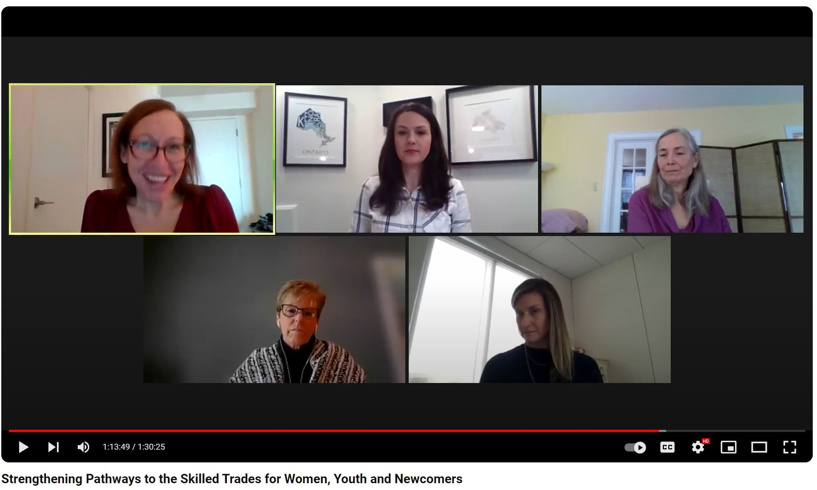
Strengthening Pathways to the Skilled Trades for Women, Youth and Newcomers
Moderated by Colleen Dignam, Workforce Development Management Consultant, City of Toronto Employment and Social Services (moderator)
Webinar, Friday, March 11, 2022

Slide 12
HAPPY TO ANSWER ANY QUESTIONS Contact Us at info@icecommittee.org

