Slide 1
The Gig Economy and its Effects on Racialized and Immigrant Populations in Toronto
Evelyn Paul and Simon Webb
October 6, 2022

Slide 2
The Gig Economy Forum – Report Presentation
Agenda
Background Research
Strategic Directions and Recommendations
Project Overview
Survey Findings: Who’s included in Toronto’s Gig Economy?
Stakeholder Interview Insights
This Photo by Unknown Author is licensed under CC BY-SA-NC

Slide 3
Project Overview
Rationale, Key Objectives, Timeline, Research Process

Slide 4
The Gig Economy Forum – Report Presentation
Rationale
Important part of the labour market but cannot accurately measure
Continued speculation on the number of gig workers
Largely unknown effects on participation for marginalized and racialized groups
Impact of COVID-19 on the economy needs to be understood
Gig work and the issues surrounding the economy are particularly relevant for Toronto
This Photo by Unknown Author is licensed under CC BY-NC-ND

Slide 5
The Gig Economy Forum – Report Presentation
Key Objectives
Gather information on the size and structure of the gig economy in Toronto
Lay a foundation of what the gig economy looks like in Toronto
Identify if and which groups (women, racialized Canadians, youth, newcomers, immigrants, seniors, Indigenous Peoples, and low-income earners) are disproportionately impacted
Inform future directions on measuring the gig economy in Canada
Understand the long-term effects of gig work in an unregulated environment

Slide 6
The Gig Economy Forum – Report Presentation
Project Timeline
Phase 1
Project Initiation
(August - October 2021)
Phase 2
Engagement Readiness and Implementation
(October 2021– January 2022)
Phase 3
Reporting & Recommendations
(March 2022)

Slide 7
The Gig Economy Forum – Report Presentation
Research Process
The Project included…
Interviews with Gig Economy workers
Discussions with ICE Advisory Team
Interviews with Knowledge Holders & Gig Experts
Interviews with Gig Employers and Organizations
Gig workers Survey
Phase 1 – Environmental Scan/Literature Review
Jurisdictional Review and Summary Report
Phase 2A – Stakeholder Interviews
Pre-panel Stakeholder Interviews
Post-panel Stakeholder Interviews
Phase 2B – Panel Survey of gig workers
Survey Findings Interim Report
Phase 3 – Reporting & Recommendations
Draft Report and Presentation
Final Report

Slide 8
Background Research
Environmental Scan/Literature Review, Jurisdictional Review, Planning Context

Slide 9
The Gig Economy Forum – Report Presentation
Components of the Gig Economy
Companies who connect workers directly to consumers
Consumers who need a specific service
Independent workers paid by the gig
Includes independent contractors, consultants and freelancers; temp agency workers and on-call workers; contract company workers
Characterized by short-term, temporary, often unpredictable, lacks formal arrangements
COVID-19 increased the supply and demand for gig workers
Momentum towards recognizing gig workers as dependant contractors

Slide 10
The Gig Economy Forum – Report Presentation
Jurisdictional Review
California, USA: Prop 22 reclassifying gig workers as contractors with benefits
New York, USA: passed six bills to set minimum pay and improve working conditions for independent contractors
United Kingdom: introduced a ‘worker’ classification with benefits and protections
Australia: unified national definition of the gig economy and benefits for gig workers
Ontario: Provincial legislation proposed that would give a $15 minimum wage to app-based gig workers (pending)

Slide 11
Stakeholder Interview Insights
Discussions with gig workers, employers and knowledge holders

Slide 12
The Gig Economy Forum – Report Presentation
Stakeholder interview responses
Advantages working in the gig economy
Flexible – hours of work, work schedule, fees/payments and work location
Disadvantages working in the gig economy
Lack of job security, stability and benefits
Lack of consistency both in terms of work and the type of jobs available
Sometimes workers are competing for a limited number of contracts
Time left for other priorities
Short-term projects
Workers don’t lose their creative spark or experience monotony of full-time, routine work
Lack of established workers rights, focus is on saving labour costs
Impact on/for marginalized populations
On-the-job discrimination/harassment
Hiring discrimination
Over-represented in lower wage/lower benefit jobs
This population is often forced to take lower earning jobs more often and left without benefits

Slide 13
The Gig Economy Forum – Report Presentation
Stakeholder interview responses continued…
Benefits needed for gig workers
Medical insurance (health, dental, vision), retirement, life insurance, paid time-off
Associations, networking opportunities, student support, gig events, mentorship
Insurance packages could be included as part of contract
Dedicated staff at City
Role of Technology
Impact of COVID-19
Supports the growth of the economy
Easy access to gig workers, products and services
Essential to grow customer database and source network and suppliers
Digital knowledge essential to grow customer base
Increased lay-offs, retirement
Participation in the economy has increased
Home-delivery for necessities increased

Slide 14
The Gig Economy Forum – Report Presentation
We tested the following gig economy definition through interviews.…
The GIG economy is generally described as people working as Freelancers, Consultants, Independent Contractors and Professionals and temporary contract workers. Working in the GIG economy can be a primary source of income or could also be in addition to other work as supplementary income. Some examples of GIG economy work could include, Artists, online handyman services, driving for Uber or LYFT, delivering food, writing programming code or freelance articles as well as part-time teaching.
and received the following responses:
Generally, agree with definition
Characterized by part-time, often multiple jobs by one person
Precarious; both in terms of wages and job security
Freelance is an important, growth sub-sector of this economy
Definition needs to consider dependent contractors; those selling to only one company/employer
Include flexible
Needs to reflect the economy is more low earning self-employment

Slide 15
Who’s included in Toronto’s Gig Economy?
Panel Survey Insights

Slide 16
The Gig Economy Forum – Report Presentation
Gig Economy Panel Survey Key Takeaways
Wide-ranging types of work and work arrangements – Gig work spanned many different work arrangements, and hours. Workers often provided services to several companies. Food delivery, home-based computer work, office work and data entry were some of the most common occupations.
High levels of moderate satisfaction – 55% of gig workers were somewhat satisfied working in the Gig Economy, 36% were very satisfied.
Key Benefits of work in the Gig Economy - The four factors with the highest amount of satisfaction among respondents were: ability to control amount of work, work/life balance, flexibility of schedule, and flexibility of work arrangements.
Key challenges and priorities in the gig economy – Top four priorities: access to sick pay, job security, access to health insurance, and career growth opportunities.
Evidence of Discrimination in the Gig Economy - 14% of the marginalized populations in the survey reported issues related to discrimination that they had experienced in the Gig Economy.

Slide 17
The Gig Economy Forum – Report Presentation
Reasons for Entering Gig Economy
To what extent was each of the following statements a factor in your decision to participate in the Gig Economy? (n=163)

Slide 18
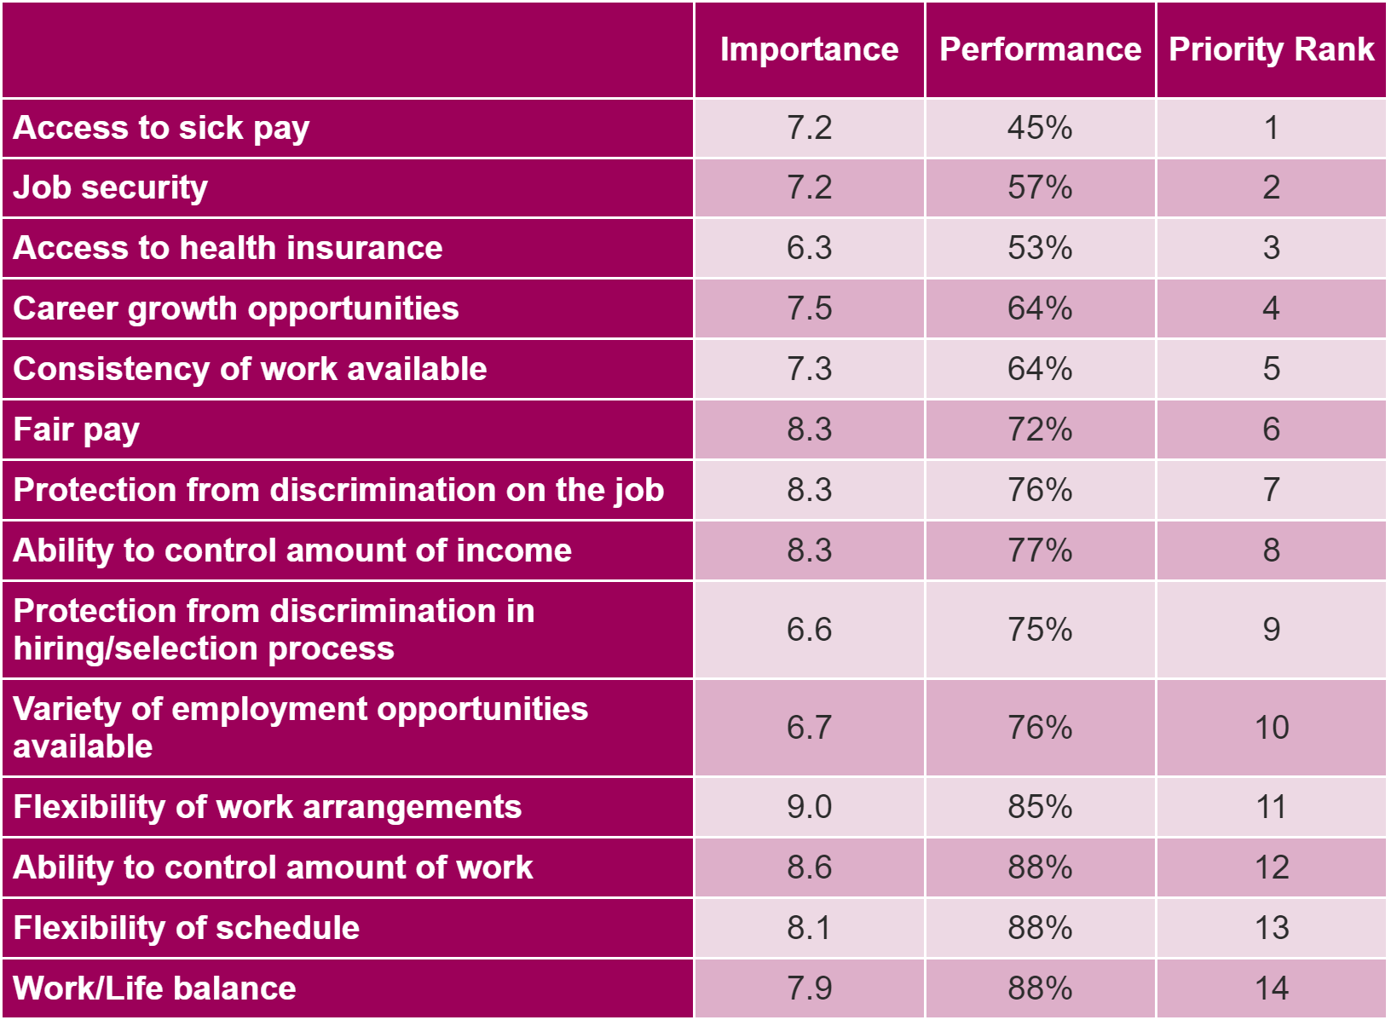
The Gig Economy Forum – Report Presentation
Gauging the Policy Priorities for Gig Workers - Priority Matrix
The Priority Matrix consists of three metrics:
Level of Importance: A statistical measure of the strength of relationship between the factor, and overall satisfaction.
Performance: The percentage of gig workers somewhat or very satisfied with this attribute of the gig economy.
Priority rank: Determined for each factor based high levels of importance and low levels of performance.

Slide 19
Strategic Directions and Recommendations

Slide 20
The Gig Economy Forum – Report Presentation
Proposed Project Definition of the Gig Economy
The gig economy is an integral part of the economic system. It represents the self-employed and non-standard workforce providing payment-by-task services to consumers through digital platforms and gig companies. While the self-employed gig worker provides services directly to the consumer, the non-standard gig worker enters into formal agreements with gig companies to provide services to the company’s clients.
Key characteristics of the gig economy include:
Part-time, temporary, short-term and flexible working arrangements
Work is often precarious as it relates to job security, benefits, and income
Segmented economy – high income/advantaged groups vs. low income/multiple jobs by one person/disadvantaged groups
Include freelancers, consultants, dependent and independent contractors, professionals, and technical service personnel.
Examples include ride-hailing and delivery, creatives (artists, writers etc.), temp-agency workers, handyman services, programming, coding, and part-time teaching

Slide 21
The Gig Economy Forum – Report Presentation
Strategic Direction 1: Adopt a standard definition to describe Toronto’s gig economy
Building from the standard definition, regularly examine the alignment of the definition.
Consult with gig worker communities, companies, researchers, and policymakers to promote a standard gig economy definition for Toronto and the province.
Continue to foster a knowledge-sharing environment within the various government entities.
Launch a marketing campaign, that clearly describe the gig economy’s various components and clarify misconceptions about this economy.

Slide 22
The Gig Economy Forum – Report Presentation
Strategic Direction 2: Focus workforce development efforts to support gig worker priorities
Engage with gig worker communities to build a continual understanding of their needs, support skills development, training, and networking opportunities.
Foster partnerships with Workforce Planning Ontario to further labour force research and resources.
Enable access and promote co-working spaces in the city as key community spaces for gig workers to meet, network and engage with clients.
Position a gig economy working group consisting of decision-makers and key stakeholders.

Slide 23
The Gig Economy Forum – Report Presentation
Strategic Direction 3: Focus research to continually inform and measure the economy
Engage with researchers to further understand which groups within the gig economy, including women, racialized Canadians, youth, newcomers, immigrants, seniors, Indigenous Peoples, and low-income earners, are disproportionately impacted.
Investigate and promote best/better practices to influence policies and further position the City of Toronto as a key enabler of a fairer gig economy.
Labour market information to understand and examine the skills levels and occupations in the gig economy.
Undertake research to understand the long-term impact of COVID-19 on the gig economy.
Continually engage with gig employers and sectors within the economy to understand their needs and undertake a sector-based approach to research and policy development.

Slide 24
The Gig Economy Forum – Report Presentation
Strategic Direction 4: Continue to track policy progress in the economy
Consider adopting the 2021 Ontario Workforce Recovery Advisory Committee (OWRAC) report and recommendations.
Continue to track Ontario’s proposed legislation that would give a $15 minimum wage to app-based gig workers to examine applicability and impact on the gig workers and the economy.
Continue to track progress on the provincial ‘portable benefits’ system, designed to benefit workers who do not have health, dental or vision coverage.
Monitor implementation of the 2020 Rebuilding Toronto’s Gig Economy Policy Brief recommendations.
Promote the federal Canada Performing Arts Workers Resilience Fund (CPAWRF) for independent and self-employed workers in the live performance sector.
Research action and outcomes resulting from the 2015 Toronto Poverty Reduction Strategy.

Slide 25
Thank you!
Evelyn Paul, Manager, Deloitte
evpaul@deloitte.ca
Simon Webb, Senior Associate, Deloitte
swebb@deloitte.ca

