Slide 1
ConnectTO: Affordable and Accessible Internet Connectivity for All
Technology Services Division

Slide 2
Digital Equity Snapshot

Slide 3
Why Digital Equity?
Access to the internet is increasingly recognized by countries and organizations around the world as an essential tool for participation in modern democratic society
The City is committed to reducing the digital divide by improving digital connectivity
Goal: Ensure that residents are connected – not divided – by technology

Slide 4
Equity through Digital Infrastructure
Equitable access is at the heart of International, Federal, Provincial and Municipal digital principles
Canada's Digital Charter Principles
Universal Access: All Canadians will have equal opportunity to participate in the digital world and the necessary tools to do so, including access, connectivity, literacy and skills.
Ontario's Smart City Framework Principles
Put people first by ensuring that Ontarians are the primary beneficiaries and valued partners in the opportunities created by the project
Declaration of Cities Coalition for Digital Rights
Universal and equal access to the internet, and digital literacy
Everyone should have access to affordable and accessible internet and digital services on equal terms, as well as the digital skills to make use of this access and overcome the digital divide.
City of Toronto Digital Infrastructure Plan
Equity and Inclusion Working Principle
Digital Infrastructure will be used to create and sustain equity, inclusion, accessibility, and human rights in its operations and outcomes. Digital Infrastructure will be flexible, adaptable, interoperable and responsive to the needs of all Torontonians, including equity-seeking groups, Indigenous people, those with accessibility needs and vulnerable populations;

Slide 5
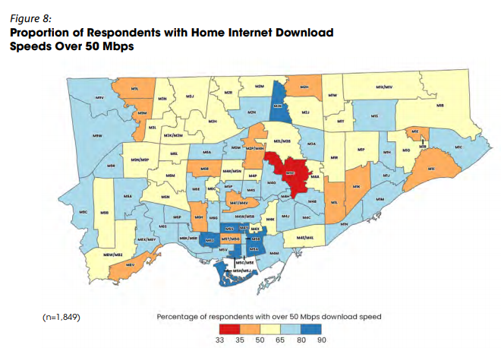
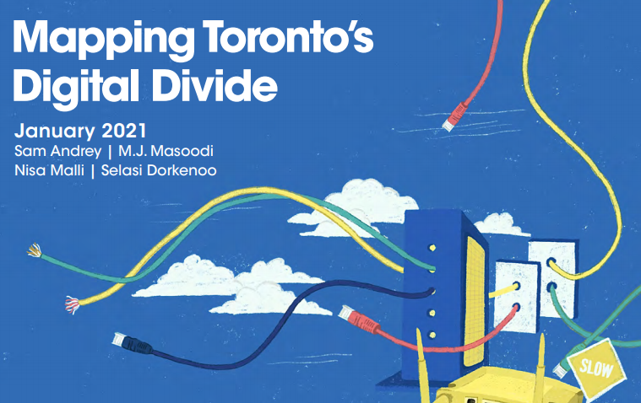
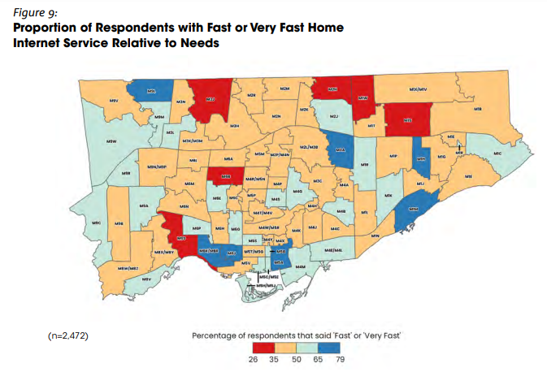
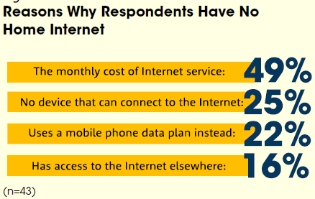
Mapping the Digital Divide?
34% of Toronto households are worried
about paying their home internet bills over
the next few months, with rates of worry
greatest among low-income, newcomer, single
parent, Latin American, South Asian, Black and
Southeast Asian residents.
38% of households report download speeds below the Canadian Radio-television and Telecommunications Commission (CRTC)’s national target of 50 megabits per second (Mbps);
Half of Toronto’s low-income households
(52%) and of those aged 60 and older (48%)
report download speeds below the national
target of 50 Mbps

Slide 6
ConnectTO Snapshot

Slide 7
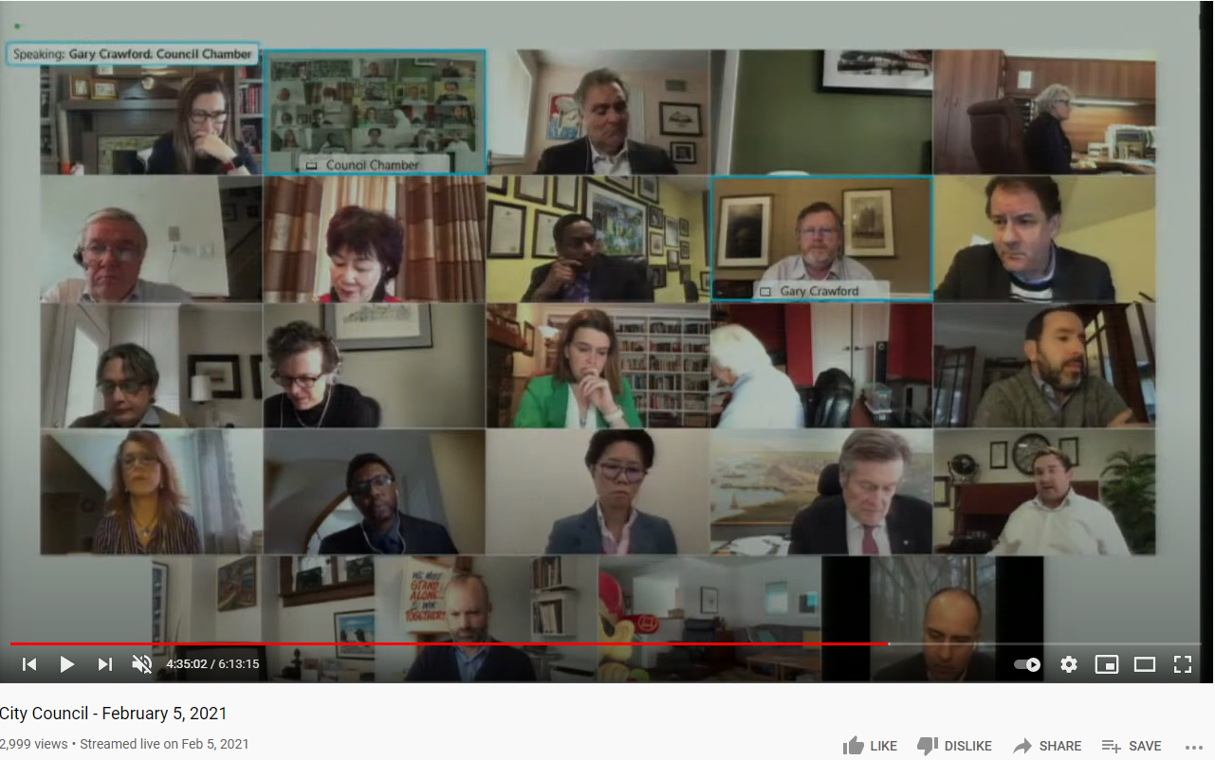
City Council Direction
Leverage municipal broadband assets

Slide 8
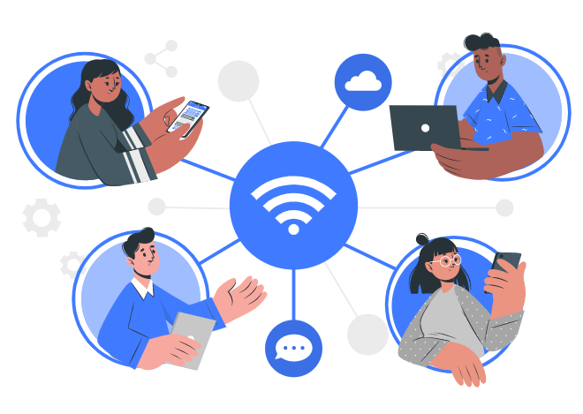
ConnectTO Broadband at a Glance
Expanded High-Speed Internet Access for underserved Torontonians
Reduce the digital divide by improving digital connectivity
Expanded Internet Access
Partnership Opportunities
Co-Development public/private collaboration
City of Toronto
Service Providers
Leverage municipal assets
Seeking innovative
Partnership
Public/Private Sector Opportunities
Municipal Broadband
Leverage municipal assets to create connected digital infrastructure
Leverage municipal broadband assets

Slide 9
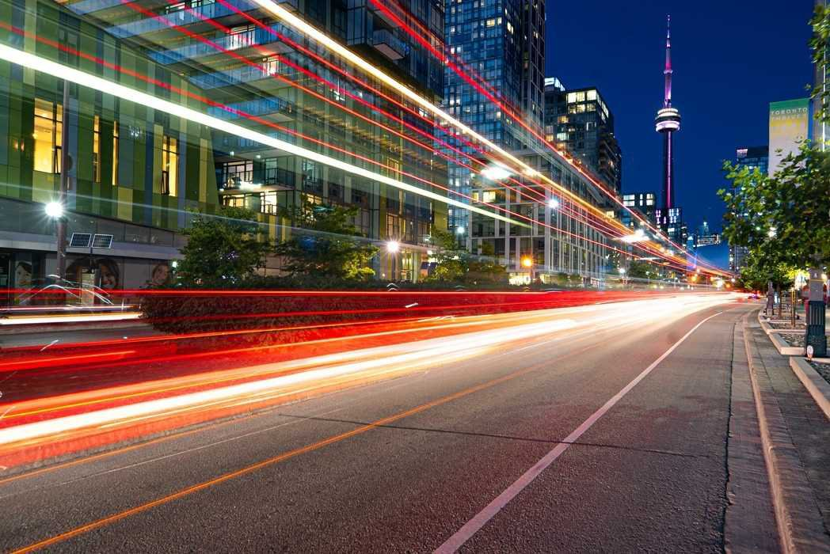
Why Municipal Broadband?
What cities need:
How to get there:
Create City-owned fibre network by:
Leveraging municipal assets to create connected digital infrastructure
Co-Development public/private collaboration
Providing open access to all qualified Telecommunications providers, at a fair price, to generate revenue and economic activity
Create digital infrastructure in underserved areas
Bridge the Digital Divide and create Digital Equity and Inclusion
Make high speed internet access affordable for all
Revenue opportunities
Continue as technology leader and economic engine

Slide 10
Pillars and Outcomes

Slide 11
Thank you

