Slide 1
Bridging the digital divide for equitable access to educational opportunities
ICE Committee Webinar
Toronto, ON
February 11, 2021
Cheryl A. Camillo, MPA, PhD
Assistant Professor;
Associate, North American Observatory on Health Systems and Policies

Slide 2
Insights drawn from 10 years experience as senior policymaker/program director responsible for eligibility for multiple
means-tested public programs (in U.S.)
Disability assistance
Free and reduced price school meals
Medicaid (public health insurance)
Low income home energy assistance program
Buildings by zaurrahimov

Slide 3
Recommendations for sustaining and expanding bridging initiatives
Assume that life will not return to pre-pandemic mode
Understand the divide is multidimensional and intersectional
Consider households’ complete circumstances
Universalize coverage to maximize take-up
Reduce administrative burdens to fill in gaps
Address rapid obsolescence

Slide 4
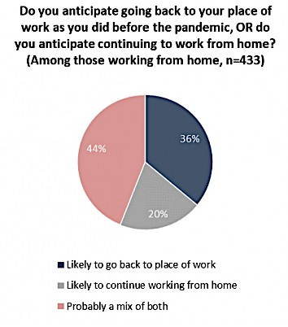
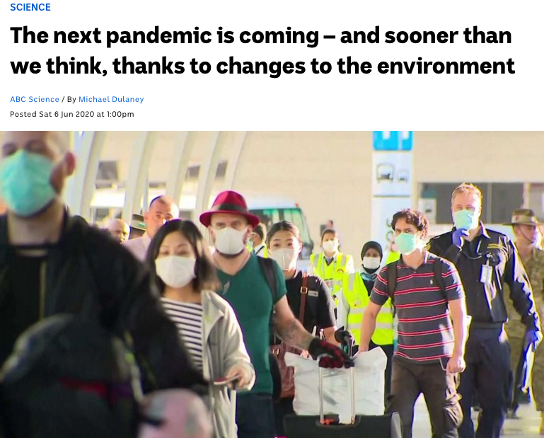
Life will not return to pre-pandemic mode
Angus Reid Institute, 2020,
https://angusreid.org/coronavirus-work-from-home/

Slide 5
The divide is multidimensional and intersectional
…physical distancing guidelines have compressed work, education, service, shopping, entertainment, and social activities into the same space—the home—the same time period—the business day—and fewer hands…
Camillo & Longo, 2020 “A Tectonic Shift in the Digital Divide” https://www.schoolofpublicpolicy.sk.ca/research/publications/policy-brief/covid-series-tectonic-shift-in-the-digital-divide.php
Cam
“she-cession”
Photo Credit: Ketut Subiyanto from Pexels

Slide 6
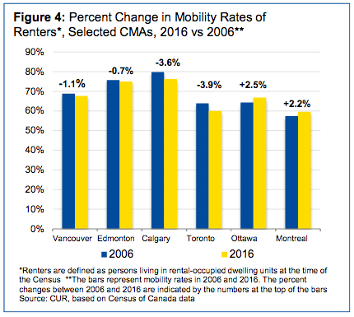
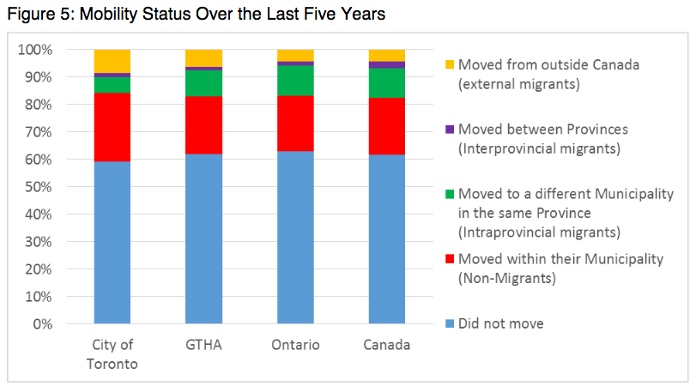
Household circumstances can affect connectivity
Pandemic-related problems paying rent might increase mobility, so consider “portable” connections
Clinkard & Clayton. 2019. Something to Think About. https://www.ryerson.ca/content/dam/cur/pdfs/Projects/CUR_Population_Mobility_in_the_GTA.pdf
Toronto. 2017. 2016 Census. https://www.toronto.ca/wp-content/uploads/2017/12/94ce-2016-Census-Backgrounder-Education-Labour-Journey-to-work-Language-Mobility-Migration.pdf

Slide 7
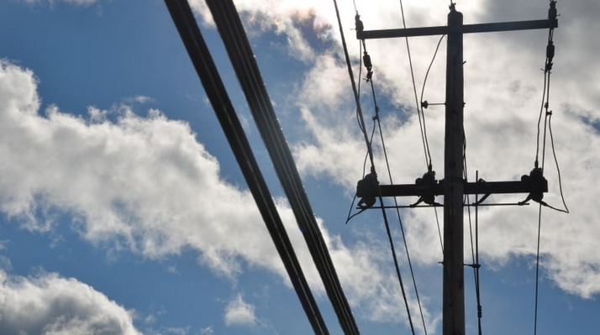
Universalize coverage to maximize take-up
Make the internet a public utility?
Photo by Erik White/CBC
Continue to leverage municipal assets?

Slide 8
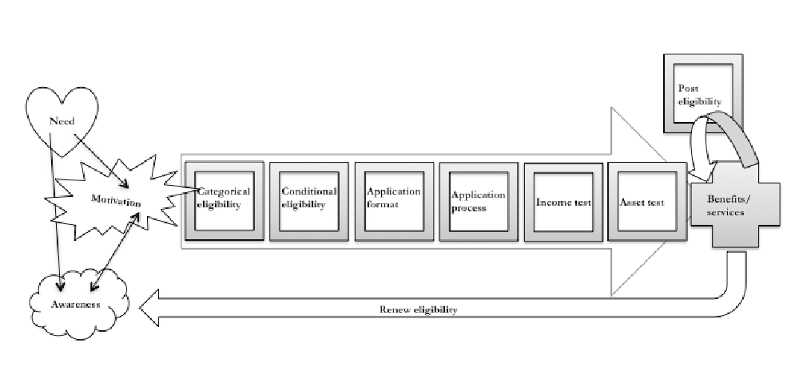
Reduce administrative burdens to fill in gaps
Examples:
Auto enroll (with opt out), including via data linkages, rather than require application
Eliminate need to pay separate monthly (for example, Rogers) bill
Drop requirement to renew eligibility
✗
Monthly fees
✗
✗
Camillo, C. A. (2021). Understanding the mechanisms of administrative burden through a within-case study of Medicaid expansion implementation. Journal of Behavioral Public Administration, 4(1). https://doi.org/10.30636/jbpa.41.196

Slide 9
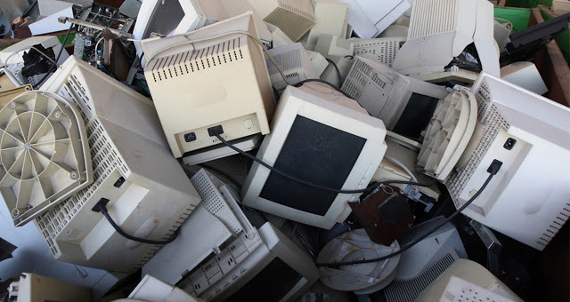
Service
support
Device
Digital literacy
Internet
connection
Address rapid obsolescence
…via negotiation and/or regulation, possibly at the national level

Slide 10
Thank you!
?
? ?
?

Slide 11
Cheryl A. Camillo, MPA, PhD
Assistant Professor
Johnson-Shoyama Graduate School of Public Policy
University of Regina Campus
3737 Wascana Parkway
Regina, SK S4S 0A2
Canada
(306) 585-4082
cheryl.camillo@uregina.ca
@CherylACamillo
https://www.linkedin.com/in/cheryl-camillo-68b0b313/

